Slide 1
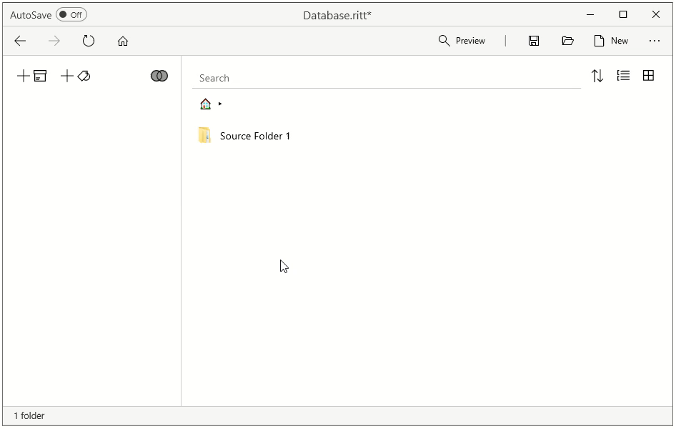

Slide 2


Slide 3
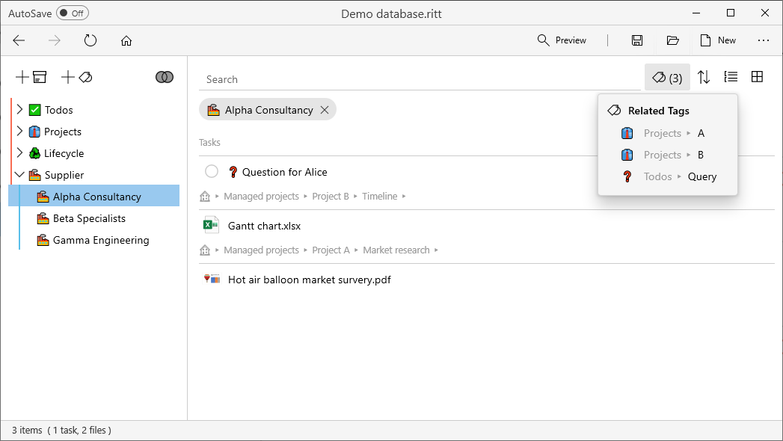
active tag(s)
tagged task(s)
related tags
tagged item(s)

Slide 4
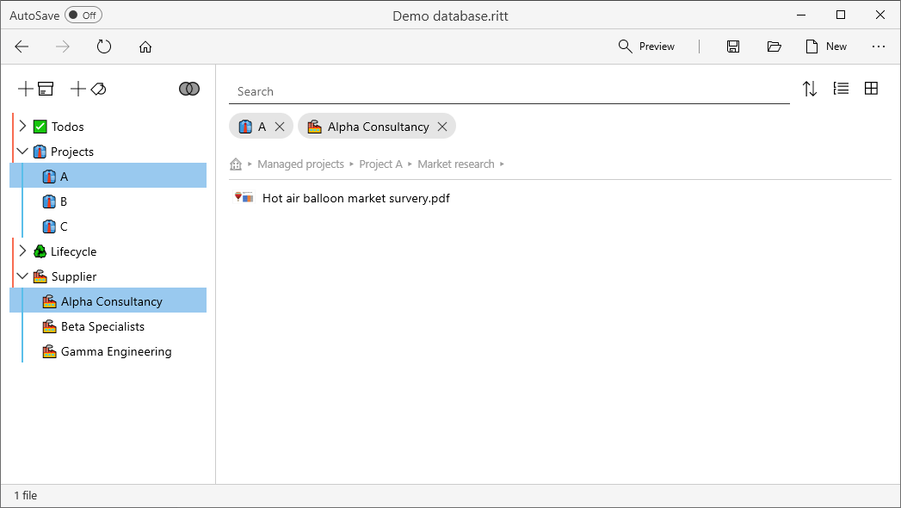
active tag(s)
tagged item(s)

Slide 5
A Source is a folder that contains items which you wish to organize using Ritt. There are two kinds of Sources.
A Source is a folder that contains items which you wish to organize using Ritt. There are two kinds of Sources.
A Source is a folder that contains items which you wish to organize using Ritt. There are two kinds of Sources.

Slide 6
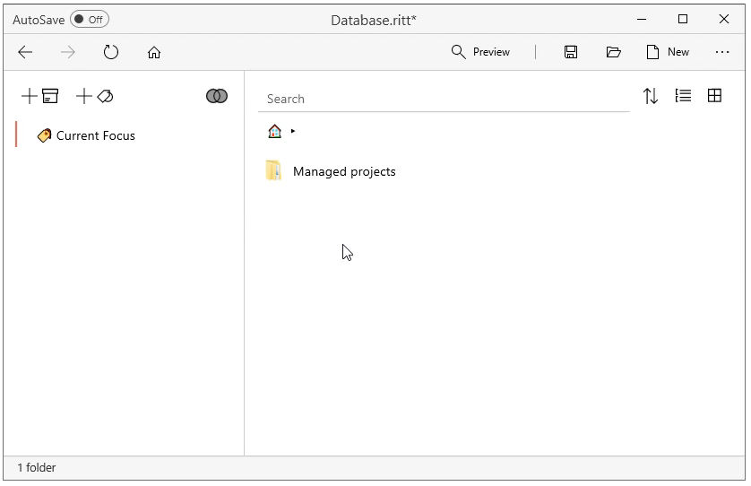

Slide 7
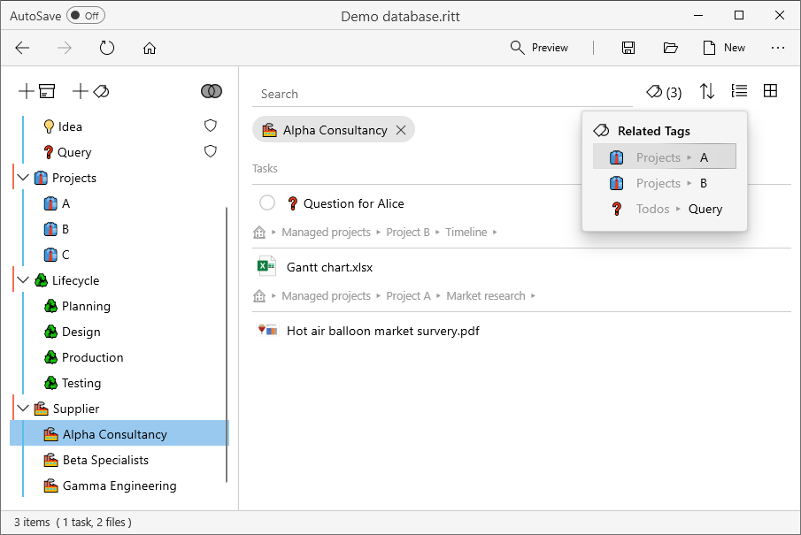


Slide 8
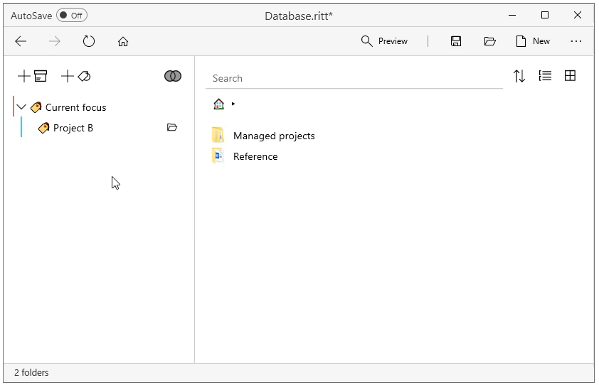

Slide 9
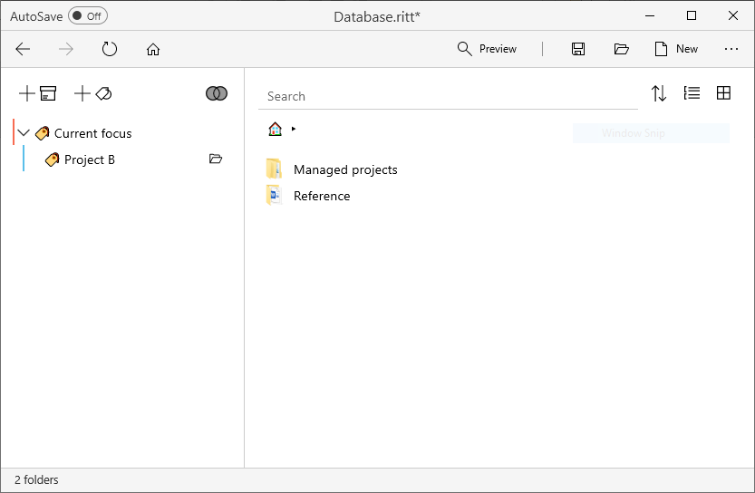
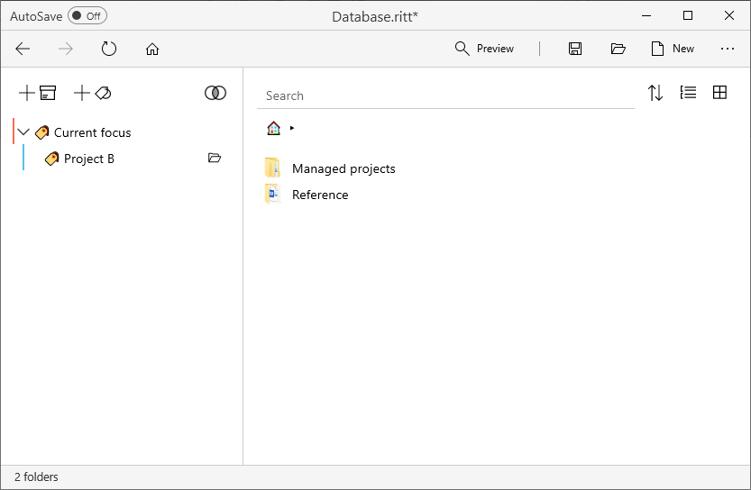

Slide 10
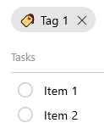
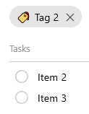
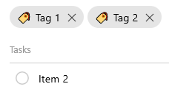
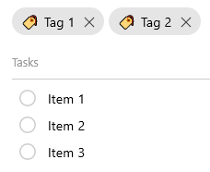

Intersection
Union

Slide 11
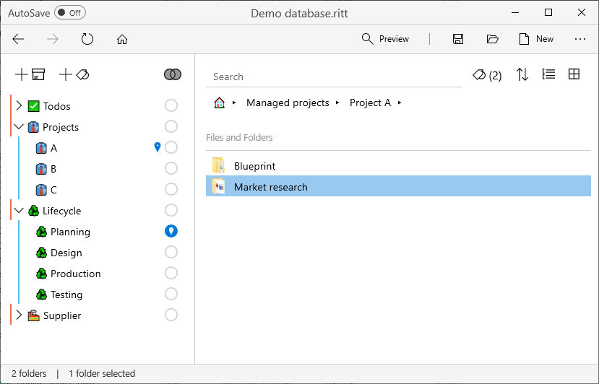
indirect tag
direct tag

Slide 12
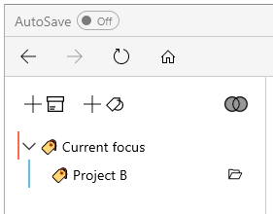

Slide 13
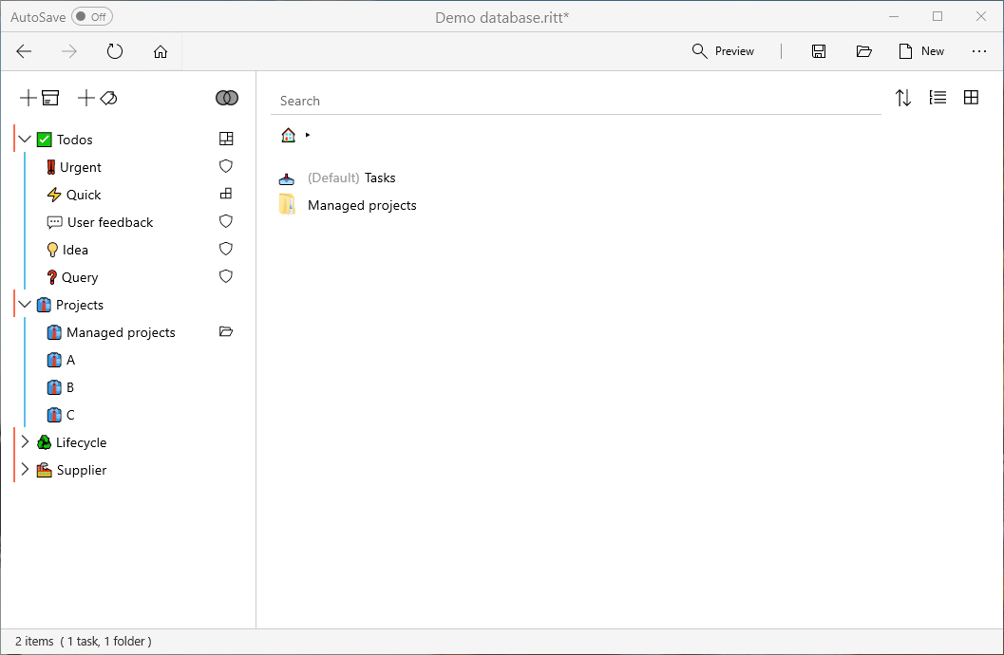

Slide 14
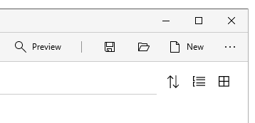

Slide 15
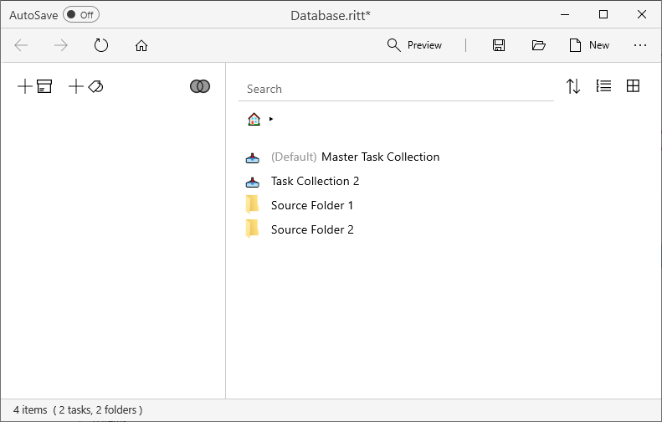

Slide 16
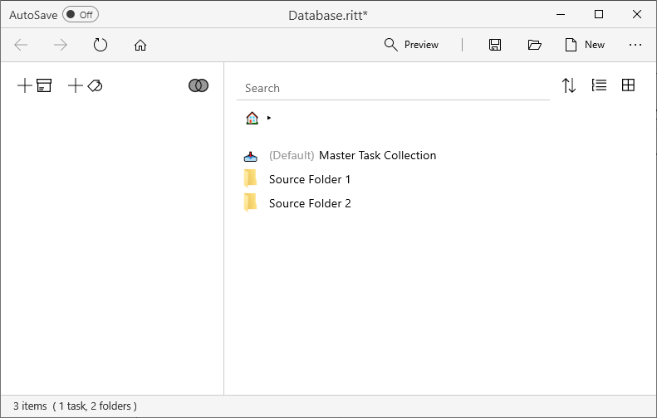
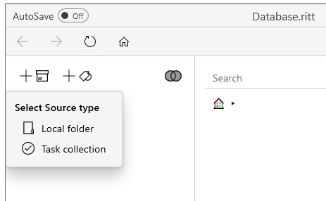

Slide 17
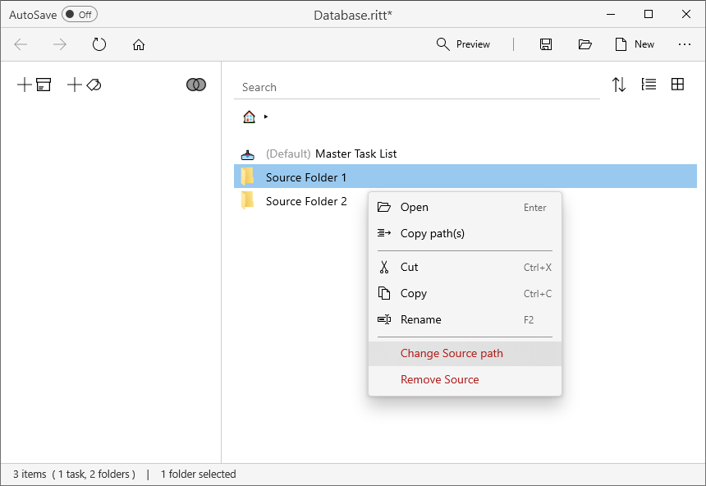

Slide 18
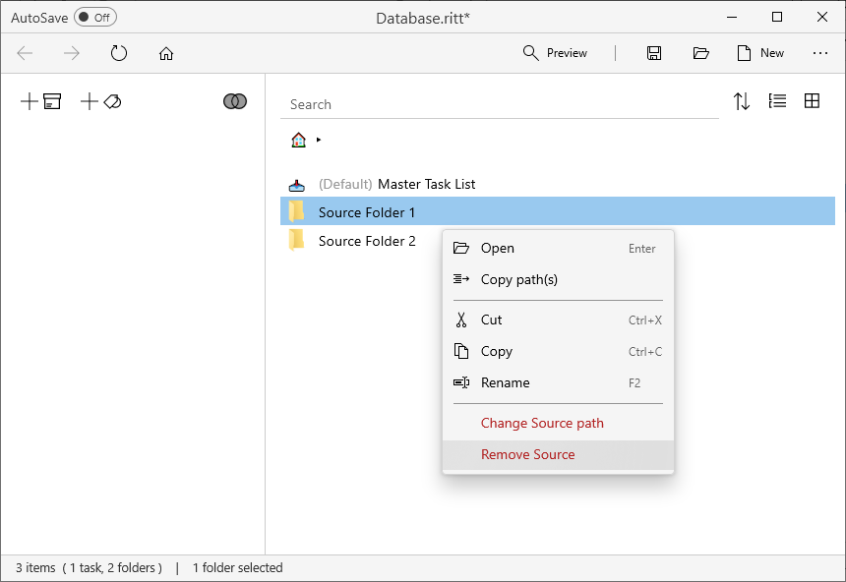

Slide 19
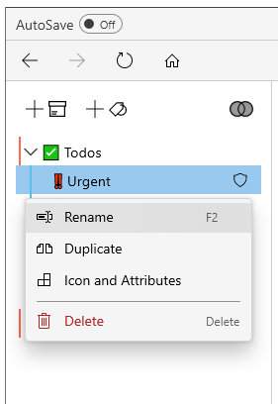
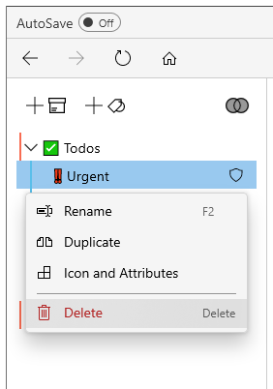

Slide 20
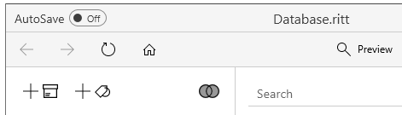

Slide 21
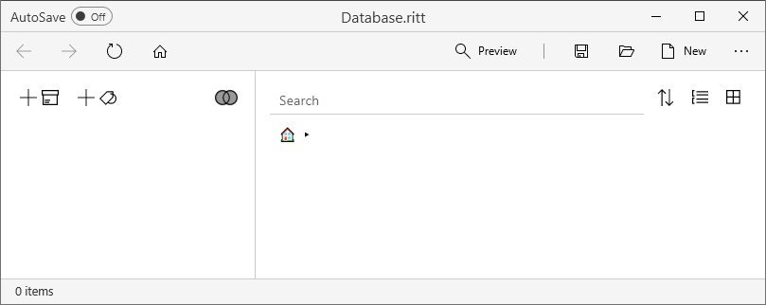

Slide 22
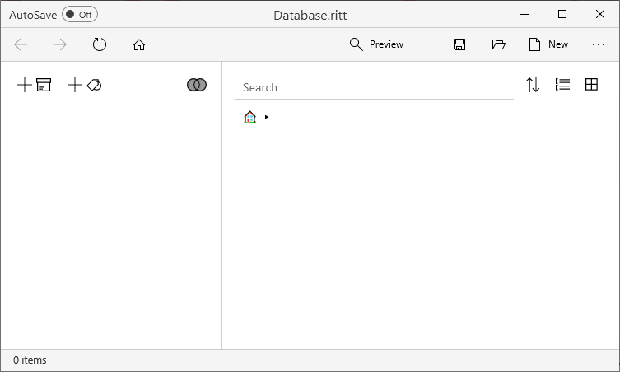
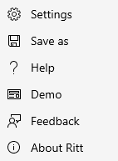
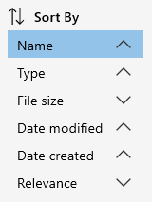
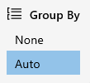
1
3
4
8
9
10
11
2
12
15
5
6
7
13
14
Tag Pane
Main Pane

Slide 23


Slide 24
1
3
4
8
9
10
11
2
12
15
5
6
7
13
14
16

Slide 25
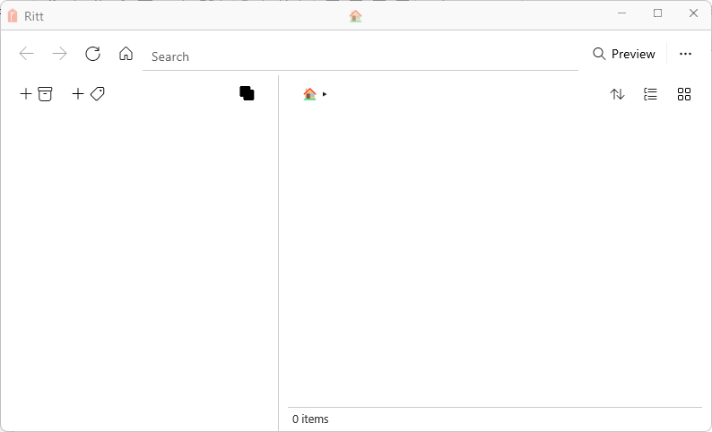
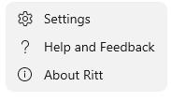
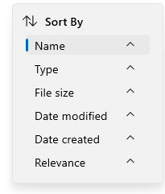
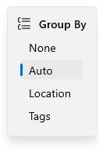
2
3
8
1
4
9
10
12
5
6
7
11
Tag Pane
Main Pane

Slide 26
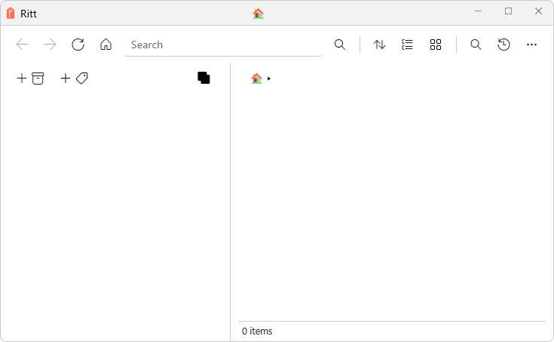
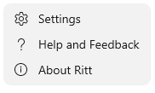
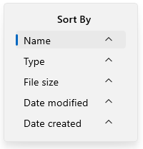
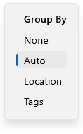
2
3
8
9
10
11
12
1
4
13
5
6
7

Slide 27
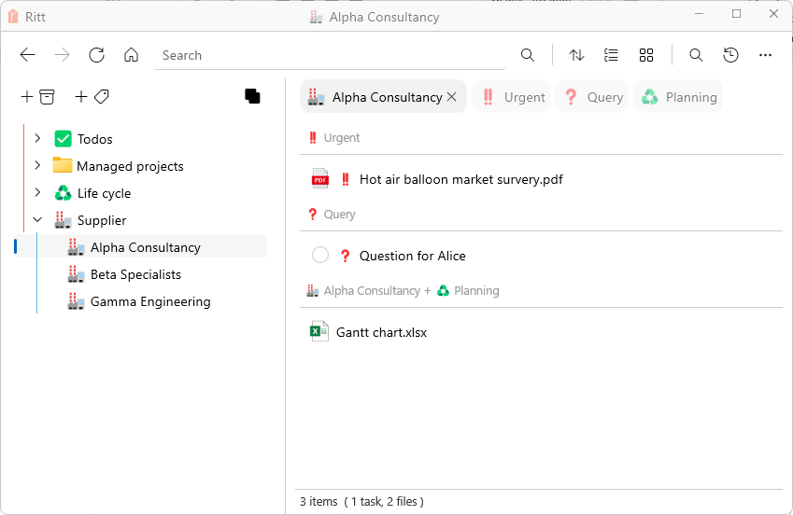

Slide 28
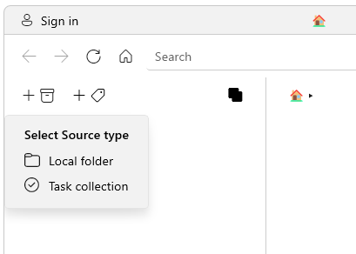
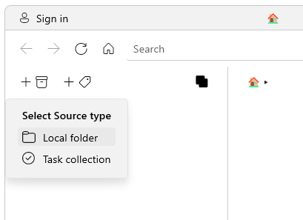
v1.0-PNG-Types-of-Sources
v1.0-PNG-Add-Source-Local-Folder

Slide 29
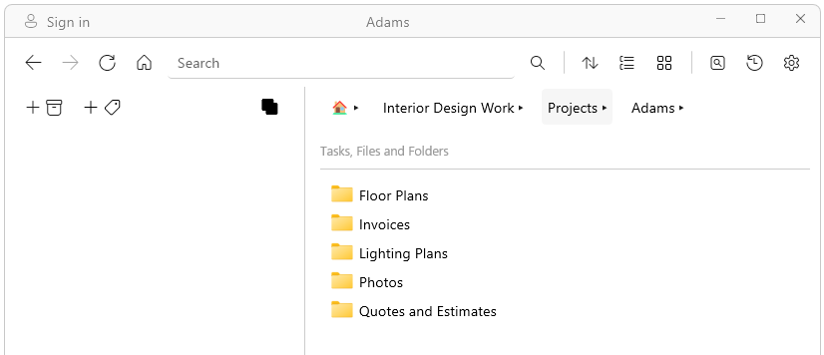
v1.0-PNG-Navigation

Slide 30
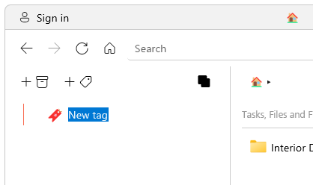
v1.0-PNG-Add-Tag

Slide 31
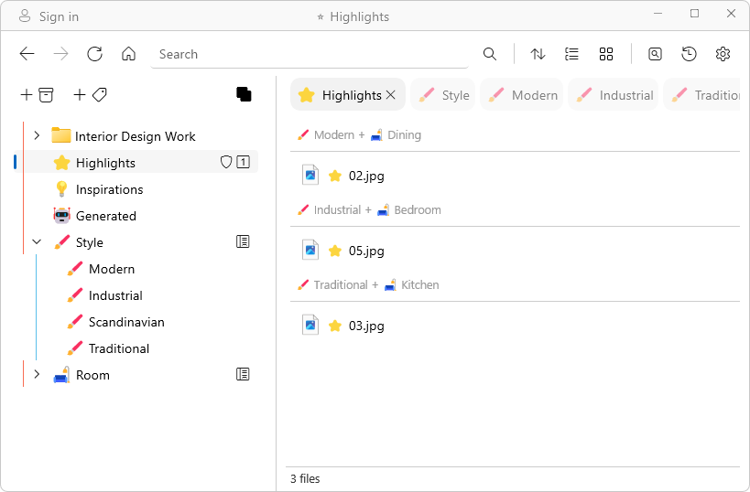
v1.0-PNG-Activating-a-Tag
active tag
related tags
tagged items
(default grouping: by tag)

Slide 32
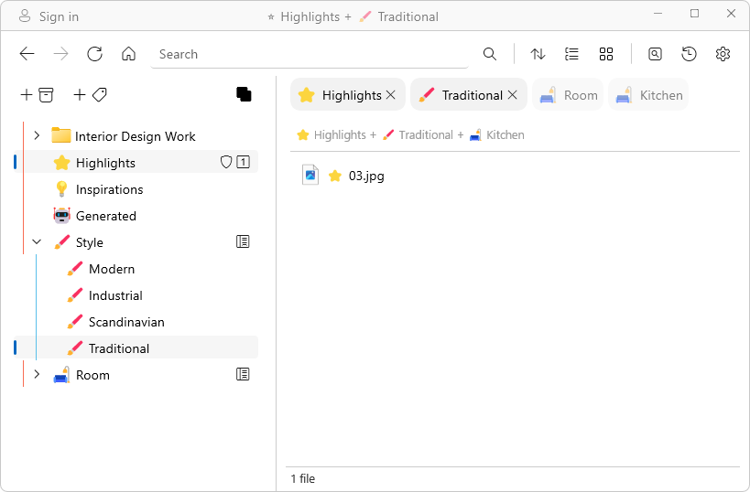
v1.0-PNG-Activating-Multiple-Tags
active tags
related tags
Item(s) under both active tags

Slide 33
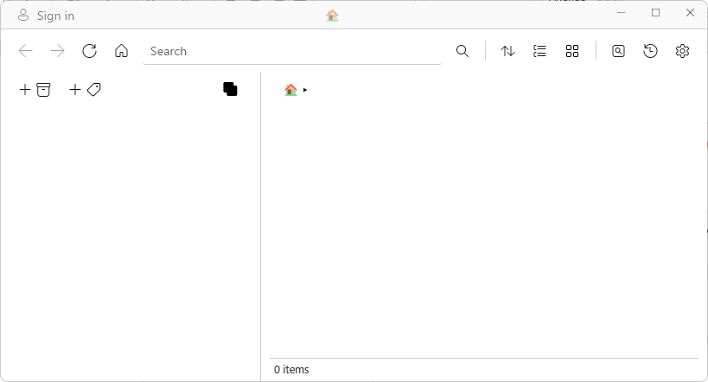
v1.0-PNG-UI-Overview
1
13
14
3
4
8
11
12
2
5
6
7
9
10
Tag Pane
Main Pane

Slide 34
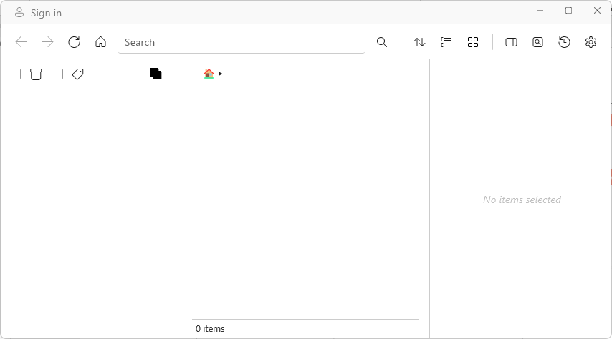
v1.2-PNG-UI-Overview
1
8
11
12
13
14
15
16
3
4
2
5
6
7
9
10
Tag Pane
Main Pane
Details Pane

Slide 35
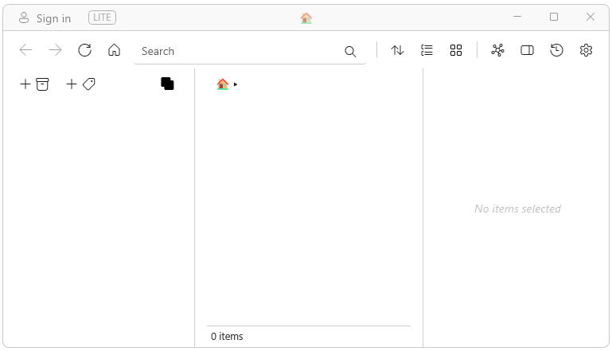
v1.2-PNG-UI-Overview-1
1
3
4
8
11
12
13
14
15
2
5
6
7
9
10
Tag Pane
Main Pane
Details Pane

Slide 36
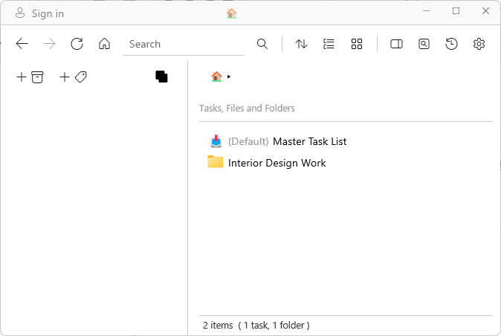
v1.2-PNG-Home-Buttons

Slide 37
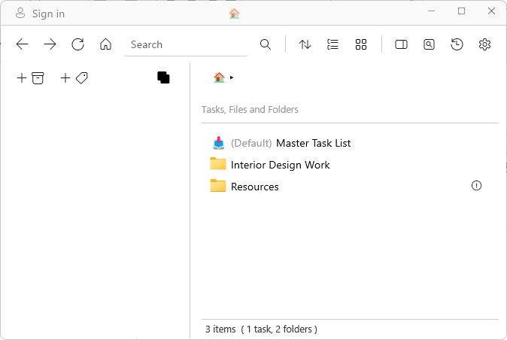
v1.2-PNG-Please-Update-Source-Path

Slide 38
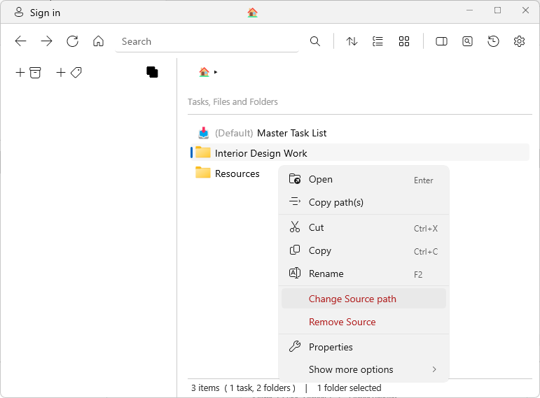
v1.2-PNG-Change-Source-Path

Slide 39

v1.2-PNG-Remove-Source

Slide 40

v1.2-PNG-Add-New-Tag

Slide 41

v1.2-PNG-Rename-Tag

Slide 42

v1.2-PNG-Remove-Tag

Slide 43

v1.2-PNG-Direct-and-Indirect-Tags
indirect
direct

Slide 44

v1.2-PNG-Tag-Icon

Slide 45

v1.2-PNG-Tag-Attributes

Slide 46

v1.2-PNG-Attribute-Dashboard
v1.2-PNG-Attribute-Badge

Slide 47

v1.2-PNG-Attribute-Badge-Example

Slide 48

v1.2-PNG-Attribute-Dashboard-Example

Slide 49
v1.2-PNG-Attribute-HotKey-Example

Slide 50


v1.2-PNG-Toggle-Intersection-Union
v1.2-PNG-Button-Union
v1.2-PNG-Button-Intersection

Slide 51


v1.2-PNG-Duplicating-a-Task

Slide 52

v1.2-PNG-Deleting-a-Task

Slide 53


v1.2-PNG-Creating-a-Task-Folder

Slide 54



v1.2-PNG-Toggle-Details-Pane
v1.2-PNG-Linked-Items
v1.2-PNG-Pin-Details-Pane

Slide 55

v1.2-PNG-Details-Pane-Notes-Section

Slide 56

v1.2-PNG-Button-Sort
v1.2-PNG-Sort-By
v1.2-PNG-Group-By
v1.2-PNG-Button-Group
v1.2-PNG-Toggle-List-Grid
v1.2-PNG-Button-Graph
v1.2-PNG-Button-Preview
v1.2-PNG-Button-History-Backups
v1.2-PNG-Button-Settings

Slide 57


v1.2-PNG-History-and-Backups
v1.2-PNG-Button-History-and-Backups
v1.2-PNG-Button-Revert

Slide 58

v1.2-PNG-Ritt-Cloud-Settings

